Slide 1
“Capital Structure”
By:
Dr. Namita

Slide 2
Meaning of capital structure
It refers to the composition of long term sources of funds, such as debentures, long term debt, preference share and equity capital including reserves and surpluses.
The financial manager should plan an optimum capital structure for his company. When the market value per share is maximum or the average cost of capital is minimum, it is called the optimum capital structure.

Slide 3
Features of optimum capital structure
Simple and flexible
Minimum risk and minimum cost of capital
Sufficiently liquid
Maximum profitablity
Retaining control by company
Avoidance of unnecessary restrictions
Fulfilling legal requirements by SEBI

Slide 4
Factors affecting Capital structure
Size of the firm
Stability of earnings
Degree of competition
Stage of life cycle of the firm
Interest coverage ratio
Cash flow ability of the firm
Cost of capital
Rate of corporate tax
Retaining control
Flexibility
Capital market conditions
Credit standing of the firm.

Slide 5
Continued…
Trading on equity
Legal requirements
Flotation costs
Leverage ratios for other firms in the industry
Nature of investors
Consultation with investment bankers and lenders
Attitude of management

Slide 6
Theories of capital structure
Theories of capital structure tries to establish relationship between capital structure decision and market value of the firm. Main theories given are:
Net income approach
Net operating income approach
Traditional approach
MM Approach

Slide 7
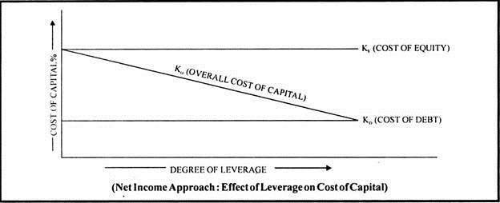
Net income approach
According to David Durand who propounded the theory capital structure decision or the ratio of debt and equity is relevant. Any change in this ratio will bring proportionate change in the value of firm and consequently in the average cost of the firm

Slide 8
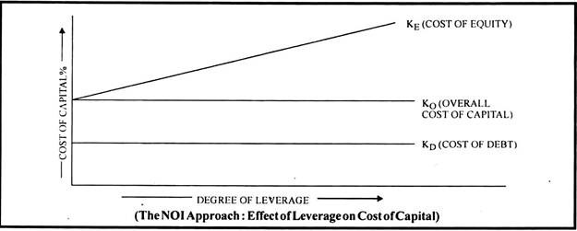
Net operating income approach
According to this theory capital structure is irrelevant for the value of the firm, as the diagram indicates overall cost of capital remains the same at each level of capital structure.

Slide 9
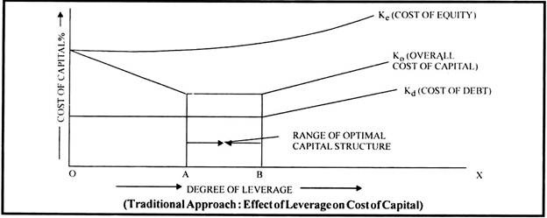
Traditional Approach
The theory states that as debt is the cheap source of fund cost of capital of a firm decreases with the increased use of debt but after a certain point the excessive use of it brings the increase in cost of equity as their risk increases and resultantly overall cost of capital also increases.

Slide 10
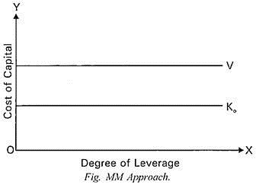
MM Approach
This theory is similar to NOI approach which states that capital structure does not effect cost of capital and value of the firm when taxes are ignored. As cost of capital decreases with the increase use of debt but the cost of equity increases by this and neutralises the effect of debt and resultantly overall cost remains the same.

